Slide 1

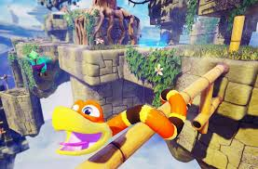
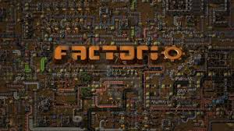
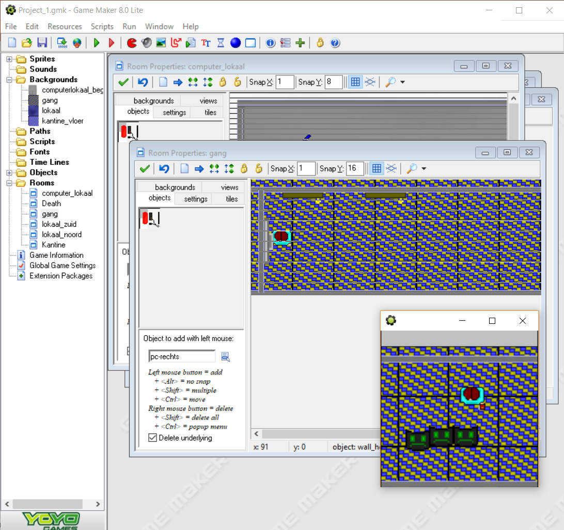


Background
C_raider
Lars keijsers
18 years old, Dutch
Photography
Technology
Not sure what to do after study
Unity
Made a dungeon crawler
Interests in games:
Problem solving/puzzle
Physics

Slide 2

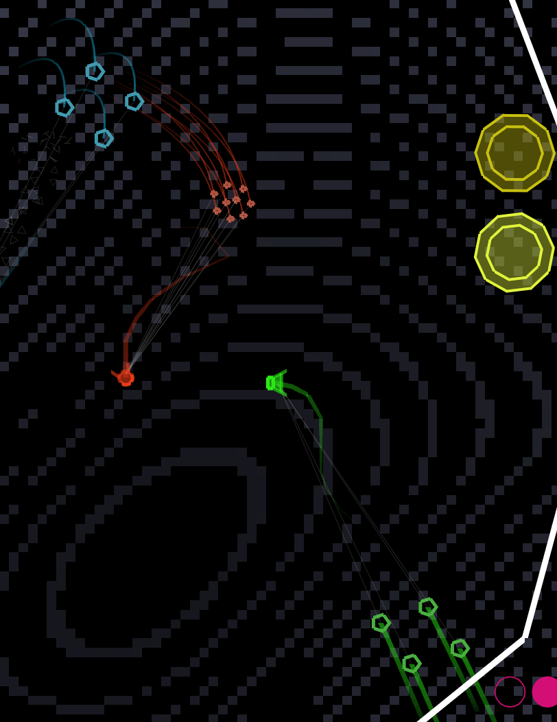
Game Concept(s)
Geometry connect
Geometry
Connect shapes
Different types
Building?

